Slide 1
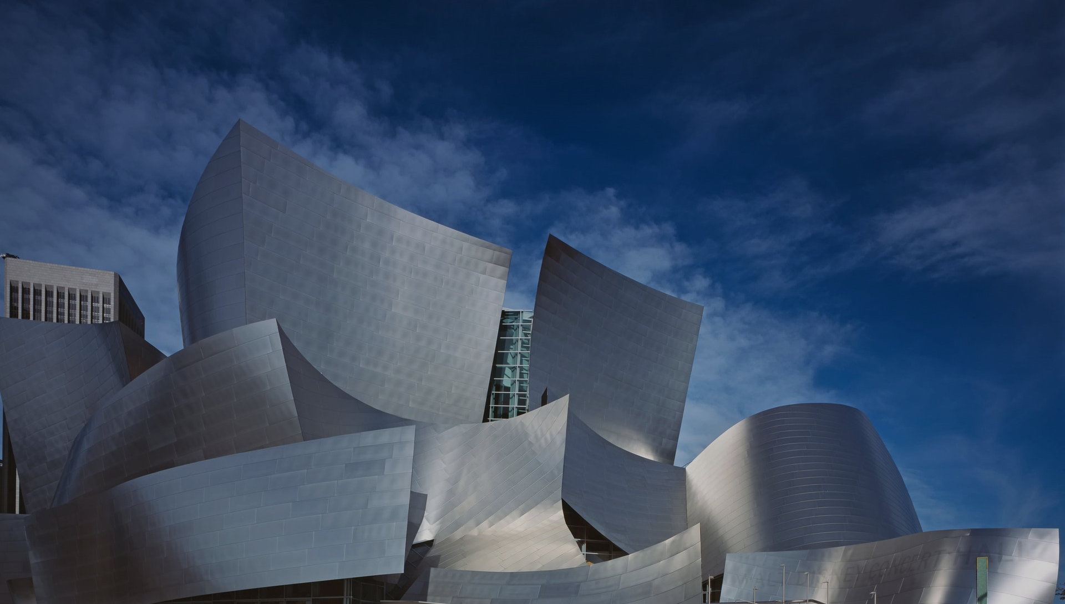
Architecture & Infrastructure As Code

Slide 2






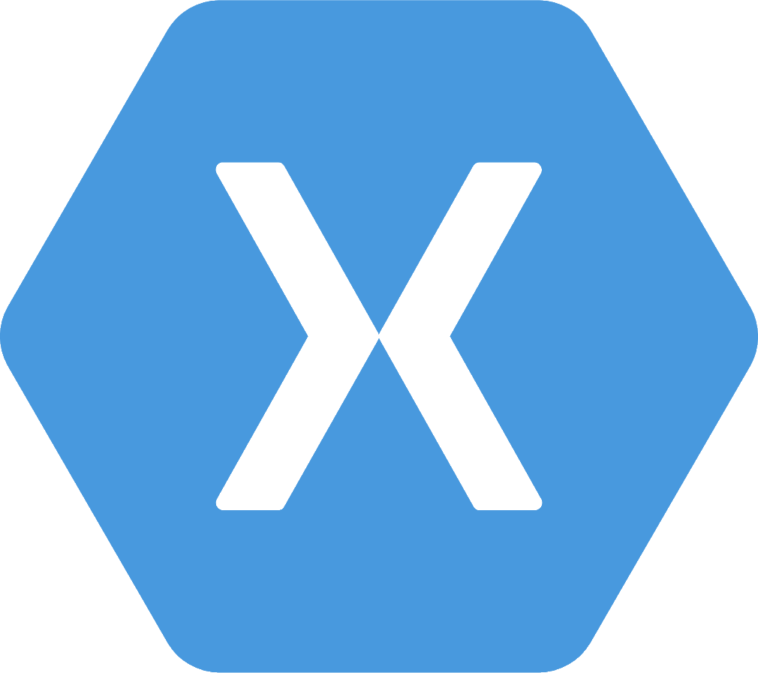

About me
Christian Eder
36 years
Father of a 2 years old daughter
→ just a little bit sleepy today ☺
@_ceder
https://github.com/ChristianEder

Slide 3

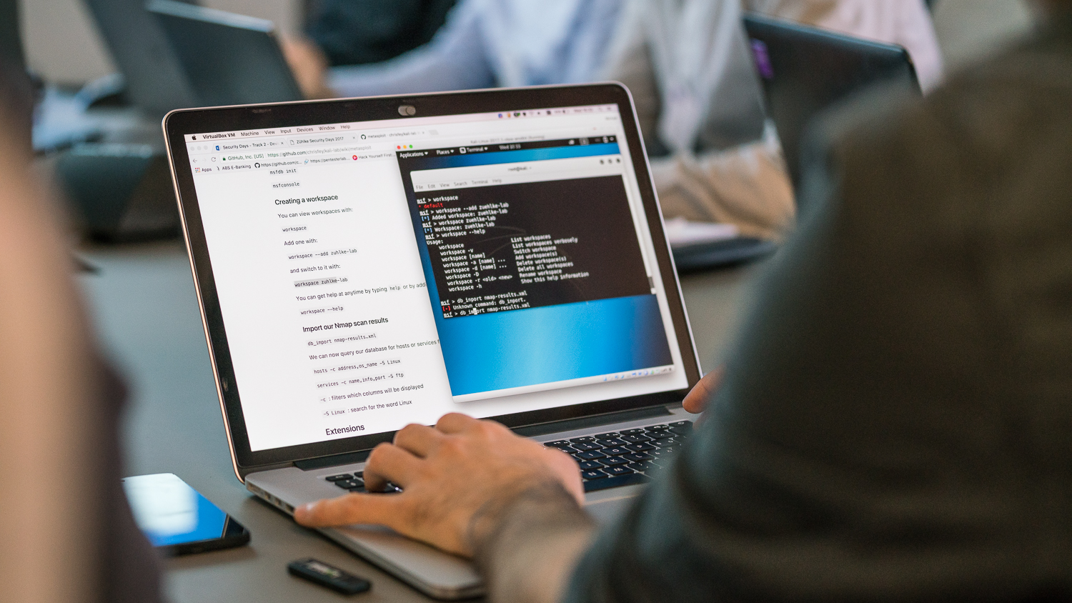



Our agenda for today
Motivation on the topics covered
Hands on coding – guided & self paced
💻
Short talks & demos of tool gems
💎
Digging deeper – hands on
💻

Slide 4

About you
Notes:
Erfahrungen mit
- Infrastructure as Code Tools?
- Architecture as Code / as text? Puml?

Slide 5
Our agenda for today
Motivation on the topics covered
Hands on coding – guided & self paced
💻
Short talks & demos of tool gems
💎
Digging deeper – hands on
💻

Slide 6
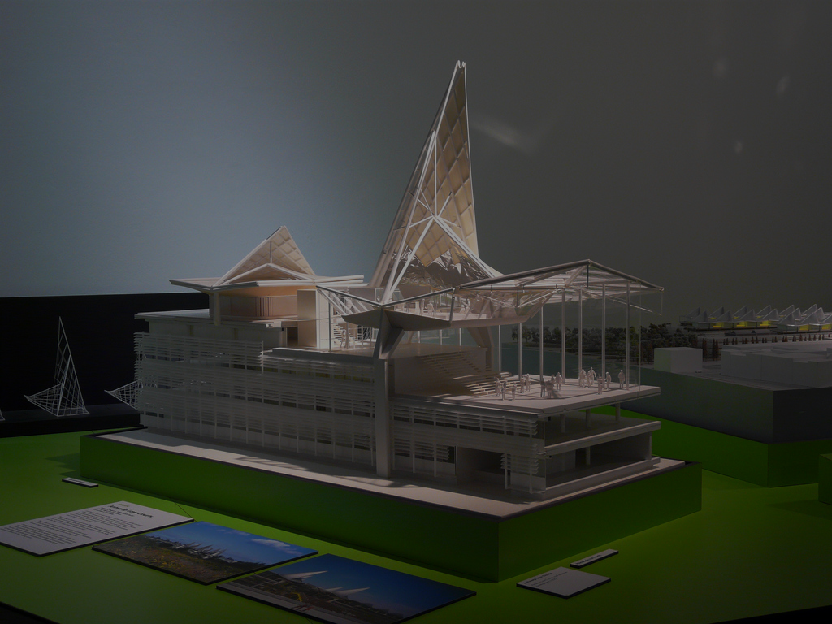
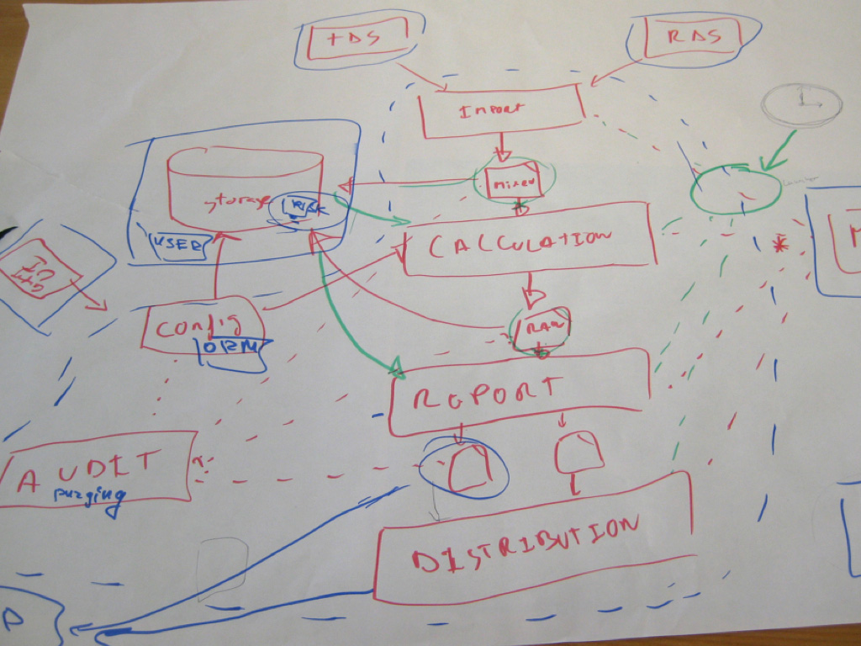
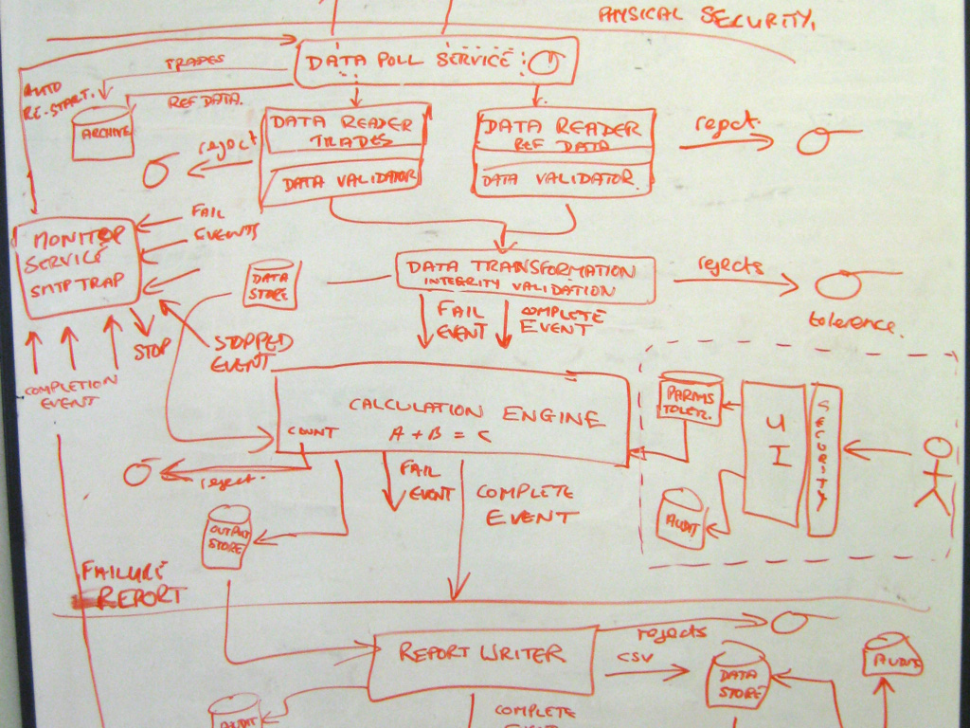
The model code gap
What does this model have in common with most software architecture models?
Doesn’t show a lot technical detail
But at least its beautiful ;-)
Most likely will never get updated when the actual thing is being built
The end result will look alike, but not the same

Slide 7
The model code gap
Models are everywhere in software development
Implementation
User and Business Requirements
Operations
Architecture
Software Product
Customer

Slide 8
The model code gap
When models don’t show the same things
Implementation
→ Code
Operations
Architecture
→ Diagrams & Documents
→ Infrastructure

Slide 9
The model code gap - effects
Architectural
Erosion
Risk of delivering “the wrong thing”
↑
Maintainability
↓
Meeting non functional requirements
↓
What could go wrong?
Notes:
Maintainability:
- Documenation & Code mismatch -> onboarding harder
NFR:
- Designed to support NFRs, but not implemented

Slide 10

Architecture Model
We all know & fear architecture models like these
But at least its beautiful ;-)
Most likely will never get updated when the actual thing is being built
The end result will look alike, but not the same

Slide 11
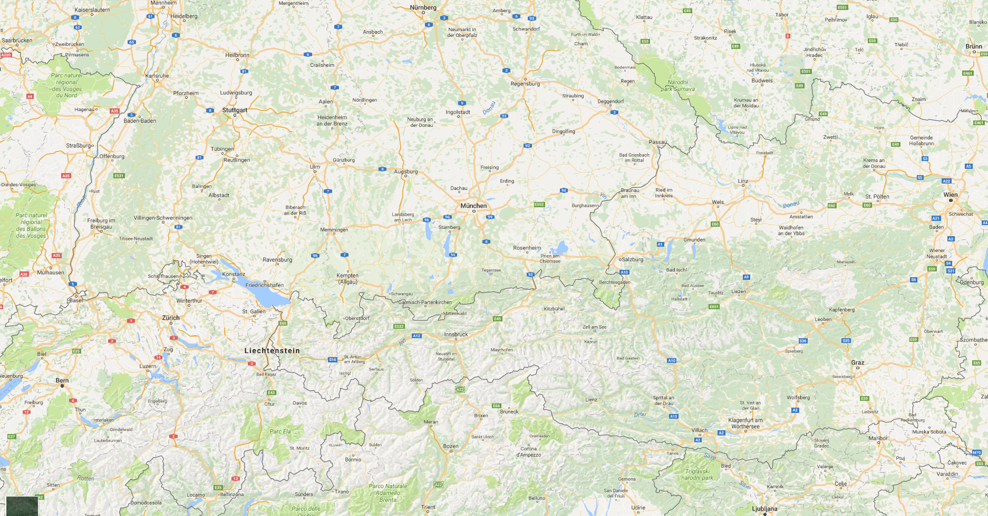
Simon Browns C4 Architecture Model
“Diagrams are maps”
System Context, Containers, Components, Classes
http://simonbrown.je
http://www.codingthearchitecture.com

Slide 12


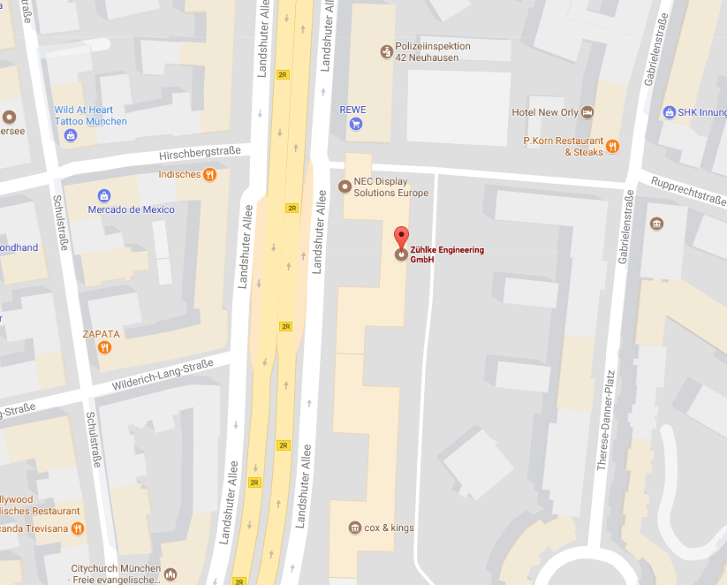
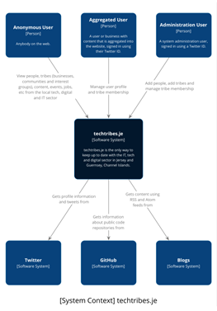
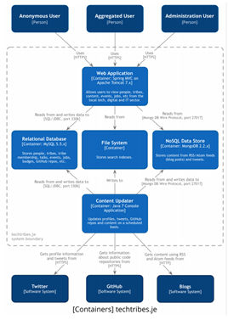
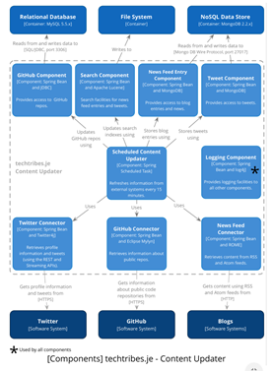
Simon Browns C4 Architecture Model
“Diagrams are maps that help you navigating”

Slide 13
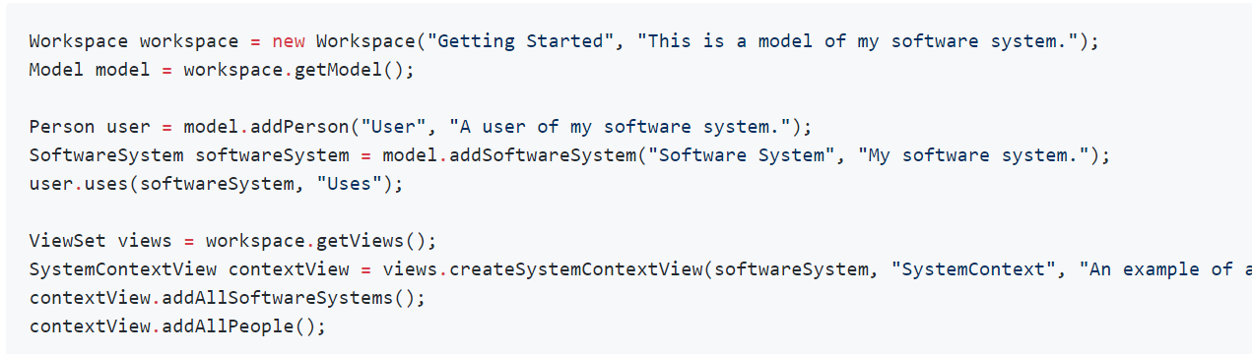
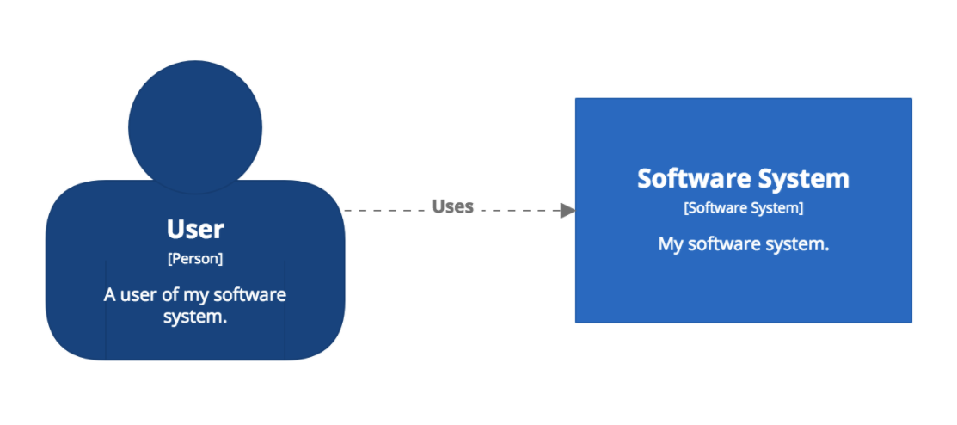
Simon Browns Structurizr
Create software architecture models based upon the C4 model using code

Slide 14

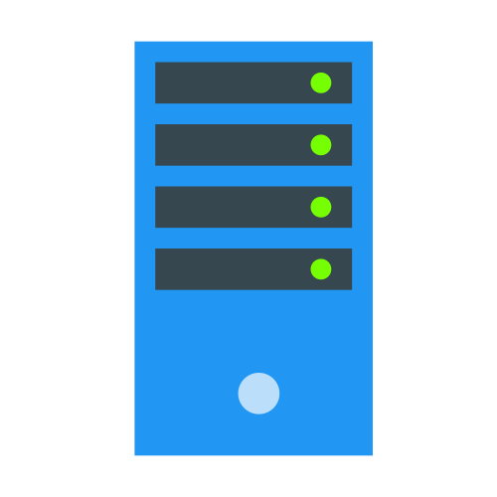


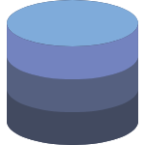
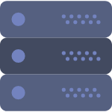
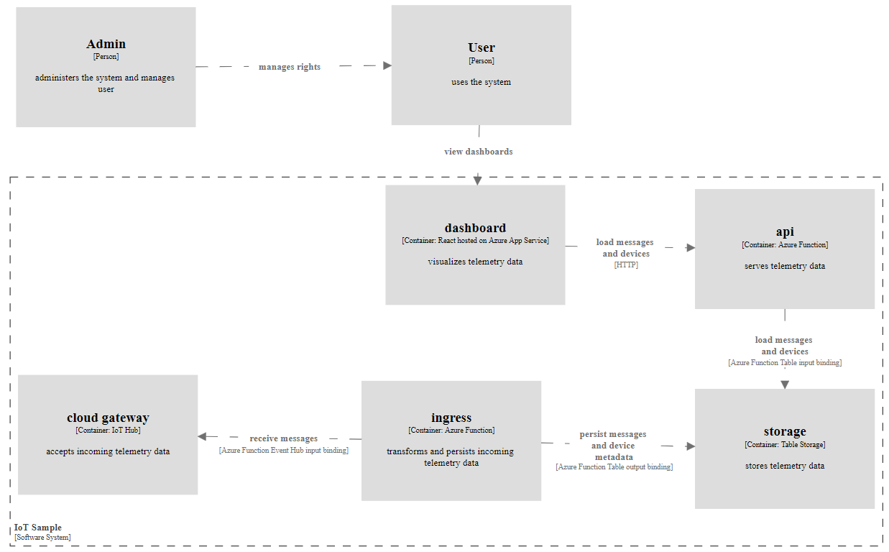
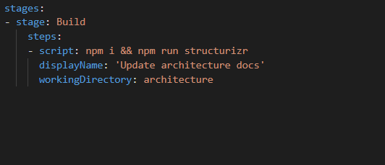
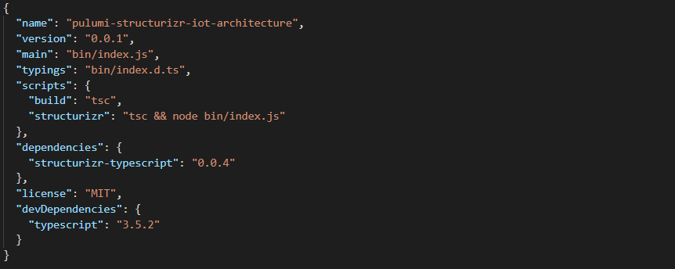
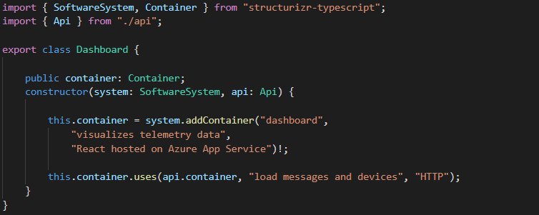
Architecture as Code
Using Structurizr – SDKs are available for Java, C# and TypeScript

Slide 15



“Infrastructure” as code
“Infrastructure” ≈ “Something that allows to run code or store data”
IAAS
PAAS
FAAS
Azure Virtual machines
AWS EC2
Azure App Services
AWS Elastic Beanstalk
Azure Functions
AWS Lambda
Azure wording: “Resources”
AWS wording: “Services”
Wording for this talk: “Infrastructure”

Slide 16
Infrastructure as code
Applying software development principles to cloud infrastructure deployment
Code
Push
Build &
Deploy

Slide 17
Infrastructure as code
There are a lot of tools to automate deploying cloud infrastructure
Tools provided by the cloud providers
Azure Resource Manager: JSON files, PowerShell, az CLI
AWS Cloud Formation: YAML files
Google Cloud Platform Deployment Manager: YAML files
Cloud agnostic tools
Terraform: custom DSL with cloud-specific providers
pulumi: TypeScript, Golang, Python

Slide 18
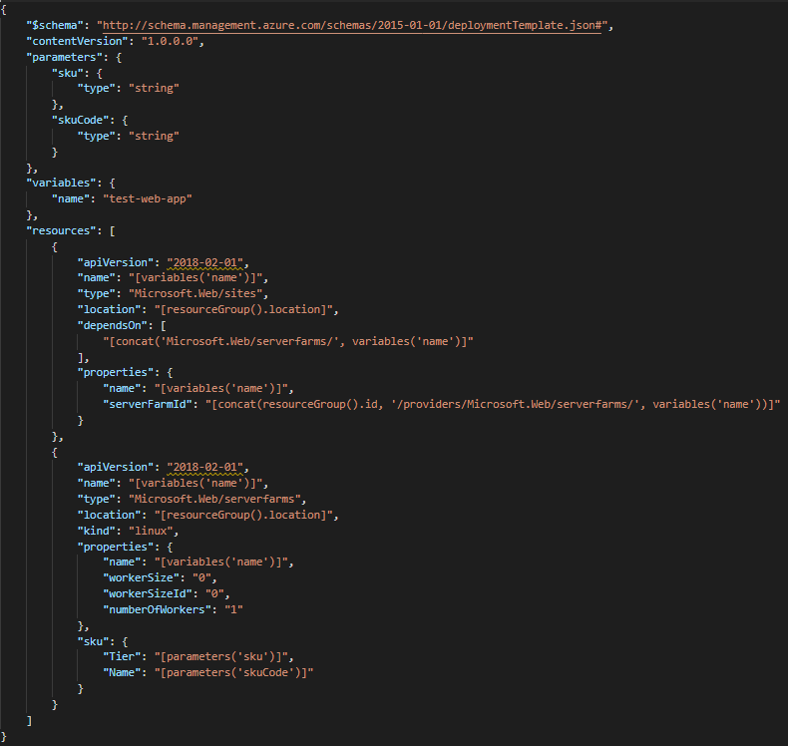
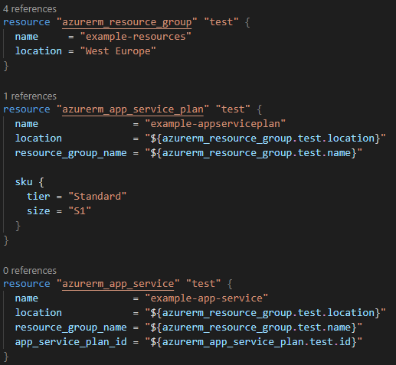
Infrastructure as Code
There are a lot of tools to automate deploying cloud infrastructure
Azure Resource Manager
Terraform

Slide 19
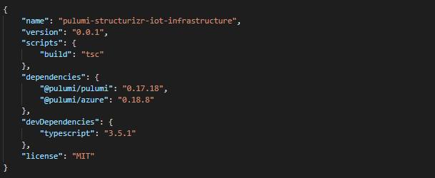
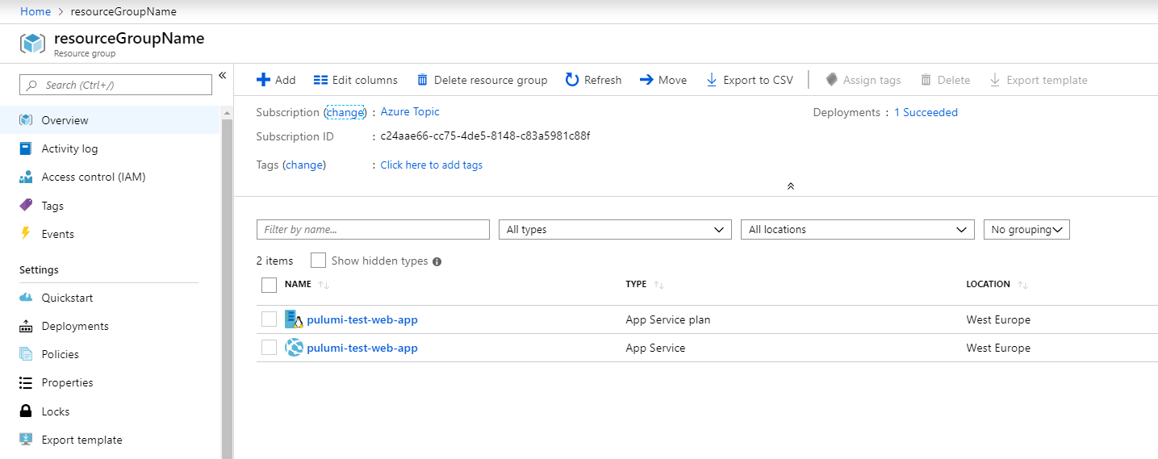
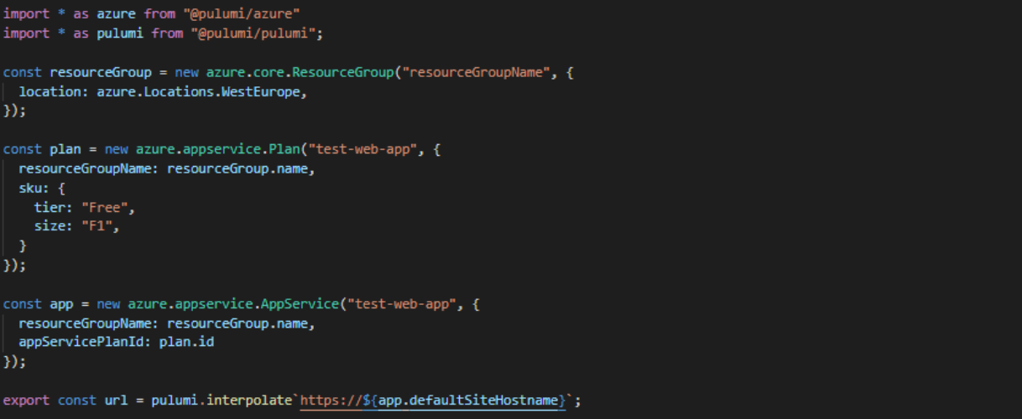
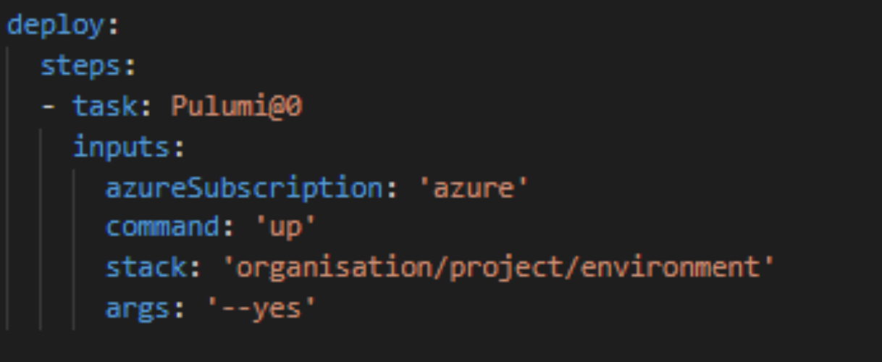
Infrastructure as Code
Using pulumi

Slide 20
Our agenda for today
Motivation on the topics covered
Hands on coding – guided & self paced
💻
Short talks & demos of tool gems
💎
Digging deeper – hands on
💻

Slide 21

Hands on
💻 Get the code git clone https://github.com/ChristianEder/pulumi-structurizr-workshop.git
🛠️ Get the tools
VS Code or Visual Studio https://code.visualstudio.com/download
.NET Core SDK https://dotnet.microsoft.com/download (or NodeJS https://nodejs.org/en/)
Optional
Azure CLI https://docs.microsoft.com/en-us/cli/azure/install-azure-cli
Pulumi CLI https://www.pulumi.com/docs/get-started/install/
GraphViz & PlantUml (e.g. via Chocolatey)

Slide 22
Hands on
To get started, see readme at https://github.com/ChristianEder/pulumi-structurizr-workshop.git

Slide 23
Our agenda for today
Motivation on the topics covered
Hands on coding – guided & self paced
💻
Short talks & demos of tool gems
💎
Digging deeper – hands on
💻

Slide 24




Priorization time!
Testing your infrastructure code
Enforcing company wide policies for infrastructure code
Automating code deployments with Pulumi
Modelling vs. Diagramming – generating multiple views from a single model
Architecture Decision Records
Self Contained Components – bringing it all together: Code, Architecture, Infrastructure

Slide 25
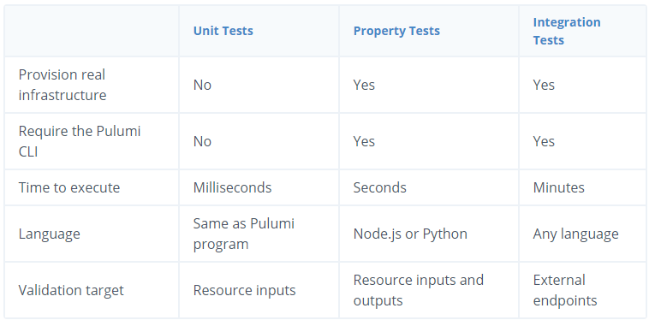
Testing Infrastructure Code
https://www.pulumi.com/docs/guides/testing/
Unit Tests are fast in-memory tests that mock all external calls.
Property Tests run resource-level assertions while infrastructure is being deployed.
Integration Tests deploy ephemeral infrastructure and run external tests against it.

Slide 26
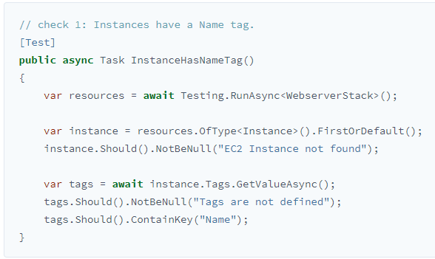

Testing Infrastructure Code
Unit Testing https://github.com/pulumi/examples/tree/74db62a03d013c2854d2cf933c074ea0a3bbf69d/testing-unit-cs

Slide 27
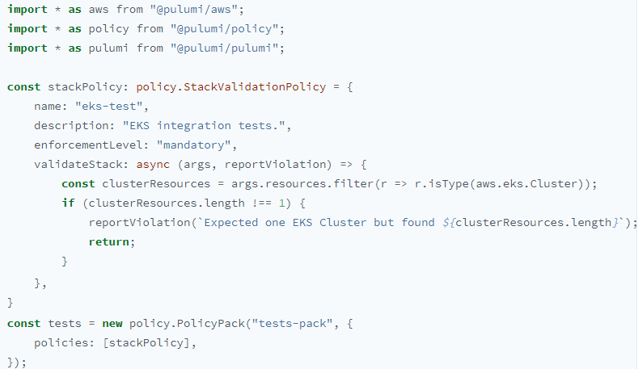
Testing Infrastructure Code
Property Testing
Property tests are based on Policy as Code, Pulumi’s offering to set compliance for cloud resources. In addition this enables another type of infrastructure testing. Each policy becomes a property, an invariant, that a test evaluates and asserts.

Slide 28

Testing Infrastructure Code
Integration Testing https://github.com/pulumi/examples/tree/05ae8e1803d7f44cecac69589175e416e421cdfe/testing-integration
Integration testing takes a different approach of unit tests: the tests deploy cloud resources and validate their actual behavior.

Slide 29
Enforcing Infrastructure Policies
https://www.pulumi.com/docs/guides/crossguard/ https://github.com/pulumi/examples/blob/master/policy-packs/azure-ts/index.ts
CrossGuard empowers you to set guardrails to enforce compliance for resources
so developers within an organization can provision their own infrastructure
while sticking to best practices and security compliance.

Slide 30
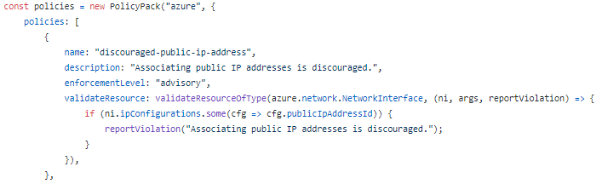
Enforcing Infrastructure Policies
https://www.pulumi.com/docs/guides/crossguard/ https://github.com/pulumi/examples/blob/master/policy-packs/azure-ts/index.ts

Slide 31
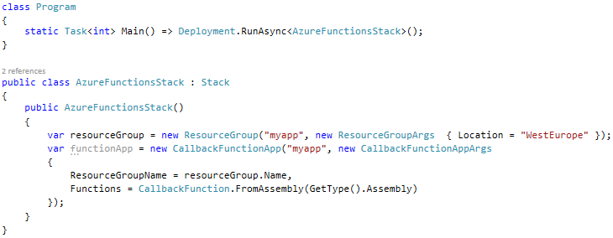
Automating Code Deployment
https://github.com/pulumi/pulumi-azure/blob/master/examples/multi-callback-all/index.ts https://dev.to/_ceder/deploying-azure-functions-using-pulumi-net-3dcb https://www.nuget.org/packages/Scratchpad.NET.Azure.Functions/

Slide 32
Modelling vs. Diagramming
https://structurizr.com/help/modelling https://structurizr.com/share/39593/985c2c39-fd88-4e2b-91e0-6c93c73b0a84
When diagramming, you're creating separate diagrams, often with an ad hoc notation, using tools that don't understand anything about the semantics of your diagrams.
With modelling, you're building up a non-visual model of something, and then creating different views (e.g. diagrams) on top of that model.

Slide 33
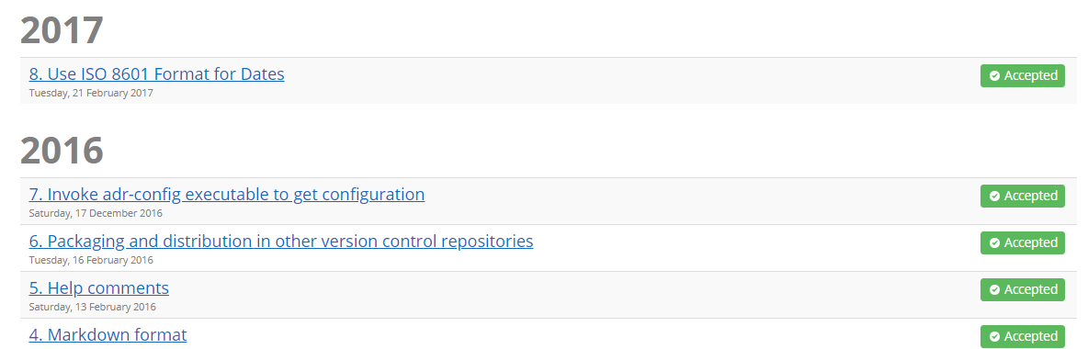
Architecture Decision Records
https://structurizr.com/help/decision-log
Diagrams alone can't express the decisions that led to a solution, Structurizr allows you to supplement your software architecture model with a decision log

Slide 34
Architecture Decision Records
https://structurizr.com/help/decision-log
Add ADRs directly from code…
… or import existing markdown files

Slide 35




Bringing It All Together — Self Contained Components
https://github.com/ChristianEder/pulumi-structurizr-workshop/tree/master/labs/dotnet/pulumi-and-structurizr
Closing the model-code gap by implementing our system as a set of components that come with
A model of their own internal architecture as well as interfaces with other components
The code implementing this architectural model
The infrastructure required to run that code

Slide 36

Recap
Code the architecture
→ Structurizr is easy and
free to start with
Start small
The example shown
today can be found at
https://github.com/ChristianEder/pulumi-structurizr-iot
Code the infrastructure
→ Start with the language you know best – TypeScript, Powershell, C#...

Slide 37

Thank you for listening – any questions?
@_ceder
https://github.com/ChristianEder

